Slide 2
Generative AI & Azure OpenAI
Hamit Sehjal
Majd Al Mnayer

Slide 3
Topics
What is Generative AI?
What is Prompt Engineering?
What are Tokens?
What is Azure OpenAI?
How to use Azure OpenAI

Slide 4
What is Generative AI?

Slide 5
Introduction to Generative AI
Definition of Generative AI
Comparison with traditional AI
Core functionalities and capabilities
Notes:
Artificial intelligence simulates human intelligence in computers, it is essentially a bunch of algorithms that train on a lot of data. Generative AI is a subset of that, that is trained on creating new content based on the data its trained on.
Generative AI refers to algorithms that can generate new content or data that's never been seen before. Unlike traditional AI, which analyzes and learns from existing data, generative AI can create novel outputs, from text to images and beyond.

Slide 6
Examples of Generative AI
ChatGPT
DALL-E 3
Google Gemini
OpenAI Sora
Midjourney
Notes:
Various examples of generative AI include ChatGPT for text generation, DALL-E 3 for image creation, Google Gemini and OpenAI Sora for advanced AI functionalities, and Midjourney for unique AI-driven journeys.

Slide 7
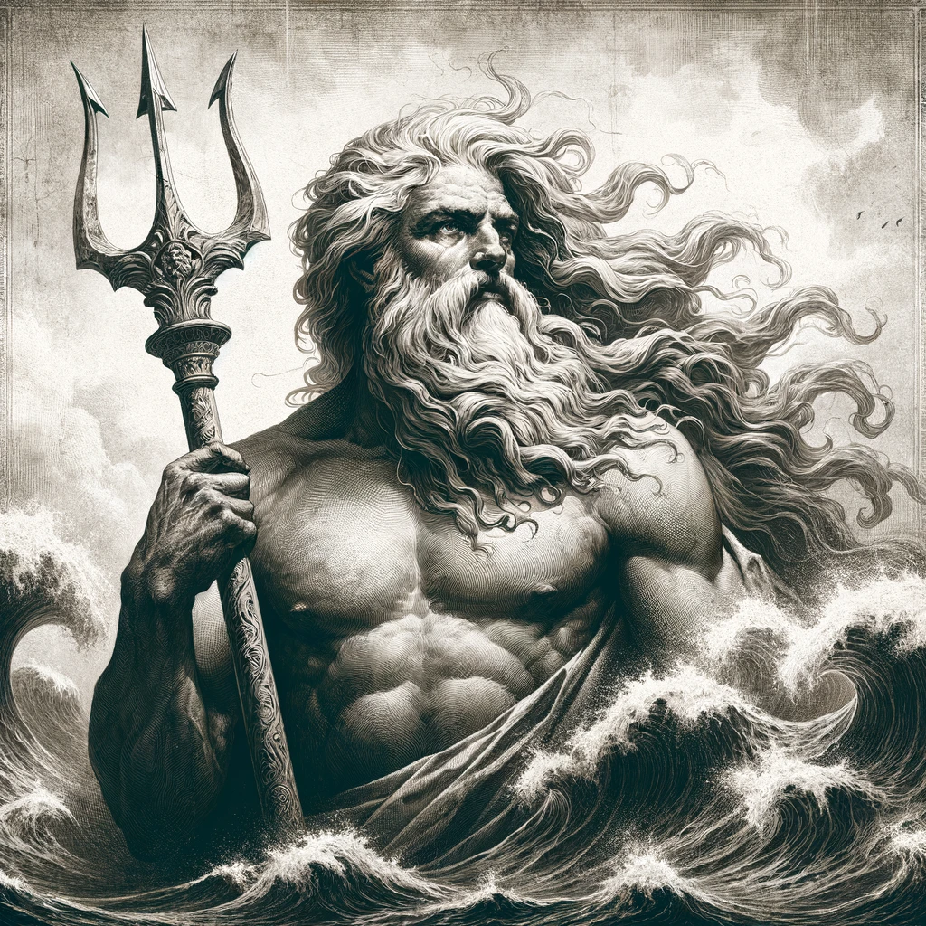
DALL-E 3 - Example
Prompt: Create an image of the Greek god Poseidon, accurately showcasing how he is depicted in the history books.

Slide 8

Sora - Example
Prompt: A stylish woman walks down a Tokyo street filled with warm glowing neon and animated city signage. She wears a black leather jacket, a long red dress, and black boots, and carries a black purse. She wears sunglasses and red lipstick. She walks confidently and casually.

Slide 9

Midjourney - Example
Prompt: A boy with a stick.

Slide 10
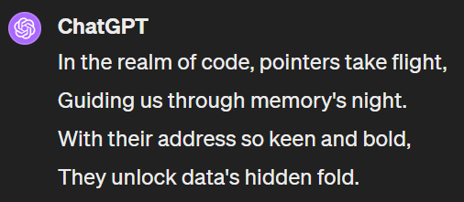
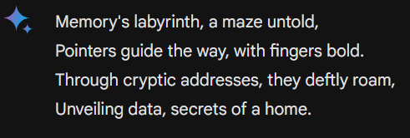
ChatGPT / Gemini - Example
Prompt: Generate a 4-line Poem about pointers.

Slide 11
Applications Across Industries
Healthcare: Drug Discovery, Personalized Medicine
Entertainment: Content Creation
Marketing: Ad Generation, Product Design
Customer Service: Chatbots, Communication Automation
Notes:
Various examples of generative AI include ChatGPT for text generation, DALL-E 3 for image creation, Google Gemini and OpenAI Sora for advanced AI functionalities, and Midjourney for unique AI-driven journeys.

Slide 12
What is Prompt Engineering?

Slide 13
The Role of Prompts
Definition
Importance of prompt engineering in AI
Impact on the output quality and relevance
Notes:
Prompt engineering is the art of crafting queries or commands that guide AI to produce desired outcomes. The quality of your prompt significantly influences the AI's output, making it a crucial skill in AI interactions.

Slide 14
Prompt Do’s
Be concise
Be specific
Reiterate most important steps
Notes:
Imagine telling an AI, 'Close the door.' Without context, the AI might not act as expected. Our skit will show how specifying 'close the door on the right, right now, quietly' guides the AI to perform precisely.

Slide 15
Prompt Example – Writing A Story
Bad Prompt: “Write a story.”
Good Prompt: “Write a captivating short story about a young detective solving a mysterious case in 1920s New York. The story should be rich in historical detail, include a twist in the plot, and end with a surprising revelation about the detective's past. The narrative should be engaging, with well-developed characters and vivid descriptions of the setting.”

Slide 16
Prompt Example – Vegetarian Recipe
Bad Prompt: “Give me a recipe.”
Good Prompt: “Provide a detailed vegetarian recipe for dinner that includes quinoa and spinach, suitable for beginners, with a preparation time under 30 minutes.”

Slide 17
What are Tokens?

Slide 18
Understanding Tokens
Definition of tokens in AI
How prompts are broken down into tokens
Each token as a unit of context
Notes:
In AI, tokens are the building blocks of communication. They can be words, punctuation, or any piece of meaningful data. Understanding tokens helps us better design prompts and interpret AI behaviors.

Slide 19
Importance of Tokens
Role in understanding and generating responses
Influence on AI’s performance and accuracy
The official pricing method of AI models
Notes:
Each token provides context that shapes AI's responses. Their significance extends beyond simple words or characters; they encapsulate meaning and intent, directly influencing AI's effectiveness.

Slide 20
Prompt Example
Prompt: Write a funny poem!

Slide 21
Tokens Example
“Write”: A verb that directs an action.
“a”: Helping to specify the task in this context.
“funny”: Adjective, descriptor that helps the AI understand the style.
“poem”: Specifies the type of the content to be generated.
“!”: Provides context regarding tone or urgency of the prompt.
Notes:
Each token provides context that shapes AI's responses. Their significance extends beyond simple words or characters; they encapsulate meaning and intent, directly influencing AI's effectiveness.

Slide 22
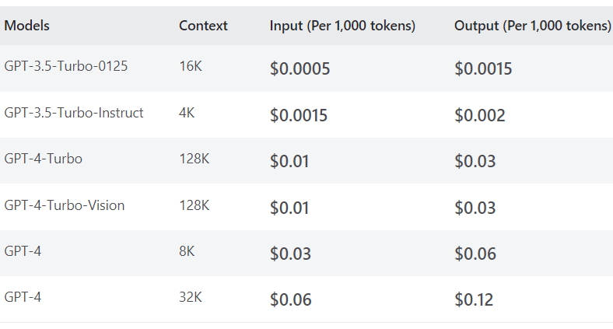
OpenAI - Pricing
Notes:
Each token provides context that shapes AI's responses. Their significance extends beyond simple words or characters; they encapsulate meaning and intent, directly influencing AI's effectiveness.

Slide 23
What is Azure OpenAI?

Slide 24
Overview of Azure OpenAI
Introduction to Azure OpenAI
Key features and capabilities
Notes:
Azure OpenAI combines Microsoft's cloud infrastructure with OpenAI's cutting-edge models. It offers robust features for creating and deploying AI models, including GPT and DALL-E 3.

Slide 25
Customization and Applications
Customizing GPT models
Creating DALL-E 3 models
Applications in business and research
Notes:
Azure OpenAI's flexibility allows for the customization of GPT models to suit specific needs, creation of DALL-E 3 models for image generation, and various applications ranging from business solutions to academic research.

Slide 26
How to use Azure OpenAI

Slide 27
Getting Started with Azure OpenAI (JavaScript)
Setting up an Azure account
Accessing OpenAI services
Notes:
To start using Azure OpenAI, you'll need an Azure account. Once set up, you can access a range of OpenAI services, tailor them to your requirements, and integrate AI capabilities into your projects.

Slide 28
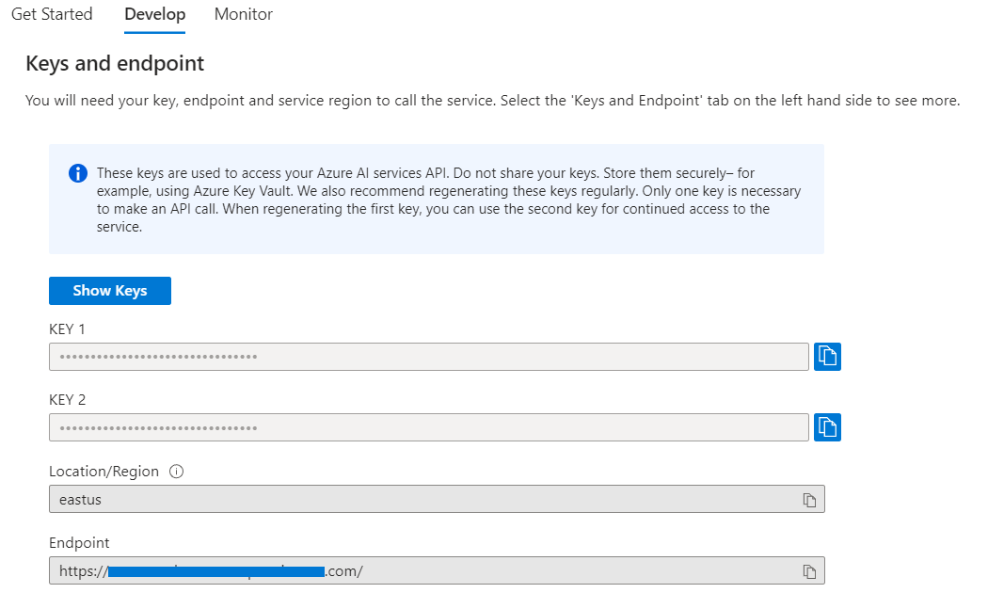
Retrieve All Credentials
Notes:
To start using Azure OpenAI, you'll need an Azure account. Once set up, you can access a range of OpenAI services, tailor them to your requirements, and integrate AI capabilities into your projects.

Slide 29
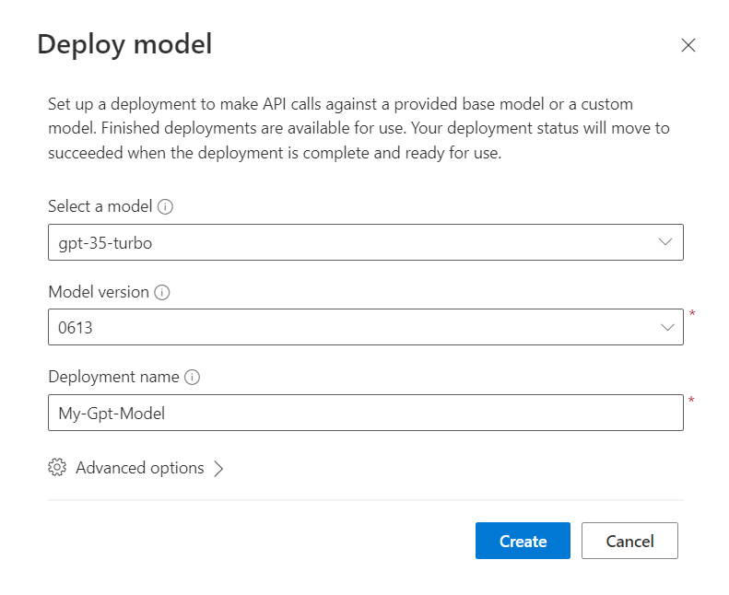
Create Your OpenAI Model
Select a model
Select a model version
Give the model a name
Notes:
To start using Azure OpenAI, you'll need an Azure account. Once set up, you can access a range of OpenAI services, tailor them to your requirements, and integrate AI capabilities into your projects.

Slide 30
Install Dependencies
npm install openai
npm install @azure/openai

Slide 31
Import and Setup
const OpenAI = require("@azure/openai");
const {OpenAIClient, AzureKeyCredential} = OpenAI;
const client = new OpenAIClient(
AZURE_OPENAI_ENDPOINT,
new AzureKeyCredential(AZURE_OPENAI_KEY)
);

Slide 32
Import and Setup
const prompts = [
{
role: "system",
content: system_prompt,
},
{
role: "user",
content: user_prompt,
},
];

Slide 33
Import and Setup
// What you named your model in Azure OpenAI Studio
const deploymentName = OPENAI_DEPLOYMENT_NAME;
// Communicate with the model const result = await client.getChatCompletions(
deploymentName, prompts, {
maxTokens: max_tokens, // 1 - 3500
temperature: temp, // 0.1 - 1
});
return result.choices[0].message.content;

Slide 34
Demo
Majd Al Mnayer

Slide 35
Demo
Hamit Sehjal

Slide 36
Thank You!

